Slide 1
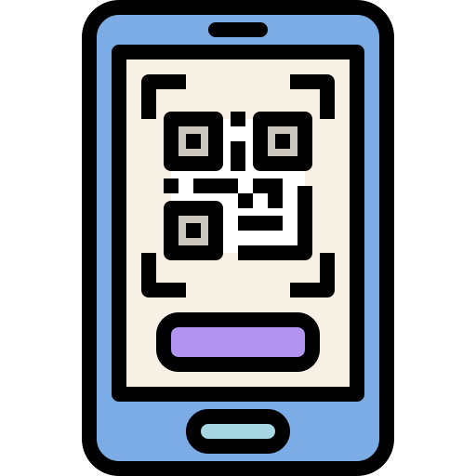


SCDF Emergency QR
108 Devs Team
Daniel Kwang, Joshua Lim, Charles Goh, Ernest Oh, Henry J.

Slide 2



Current problems
(Emergency/Non-emergency Response)
False Alarms
Slow Response
Bystander’s Inability to help

Slide 3
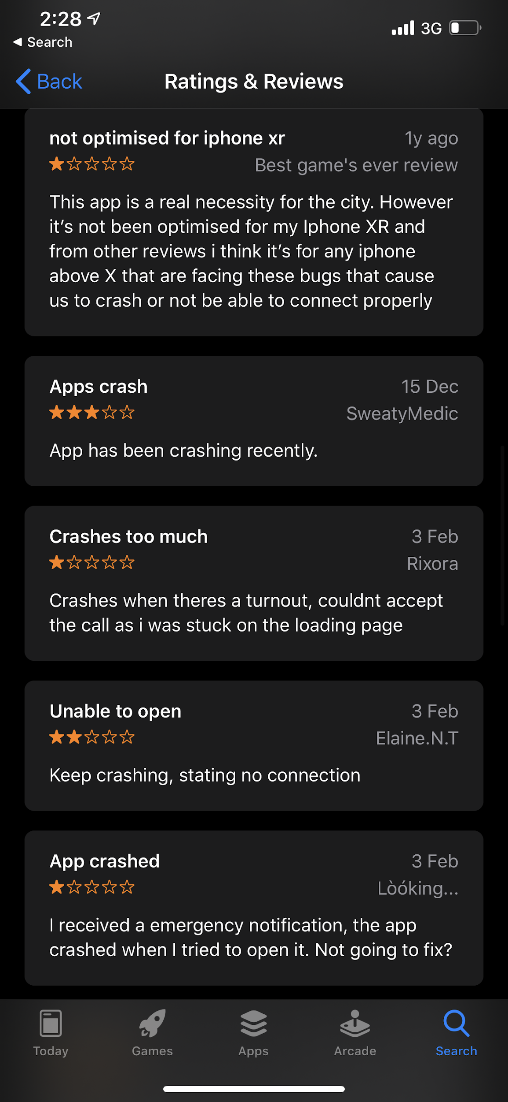
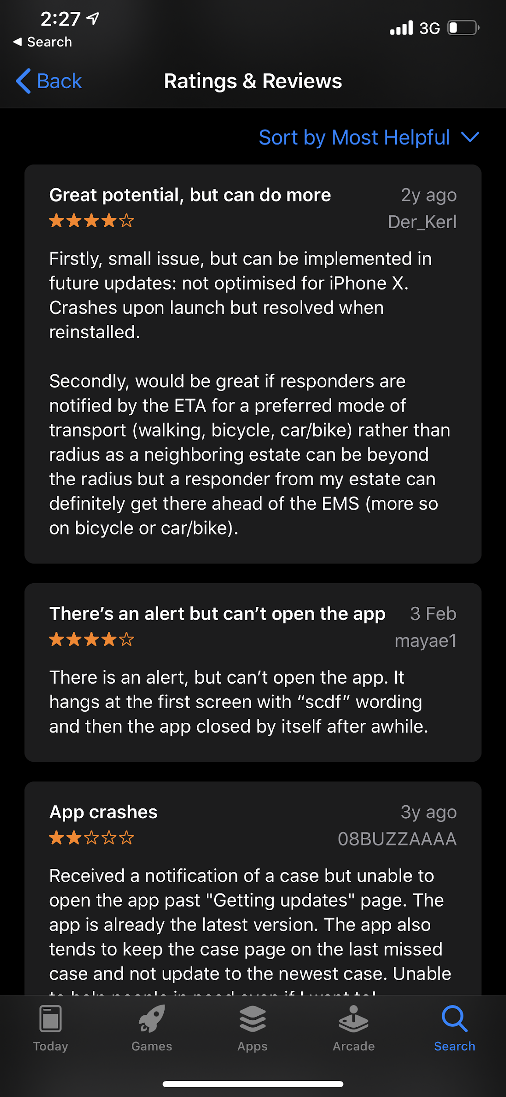
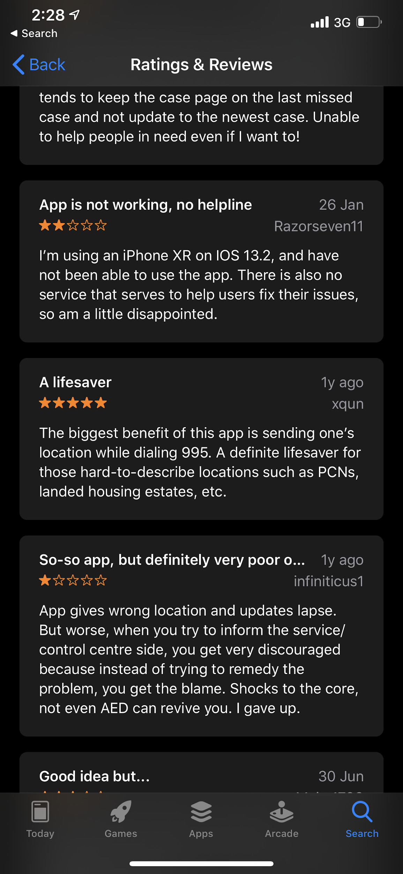
Current problems with Responses
myResponder App - Good! But needs some improvements
Slow: Need to download the app, spread awareness, and register for an account

Slide 4
Why SCDF Emergency QR?
FAST ADOPTION
NO APP INSTALLATIONS
QUICK RESPONSE DURING EMERGENCIES

Slide 5
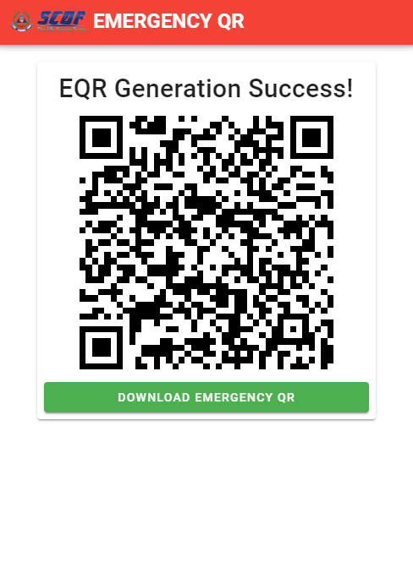
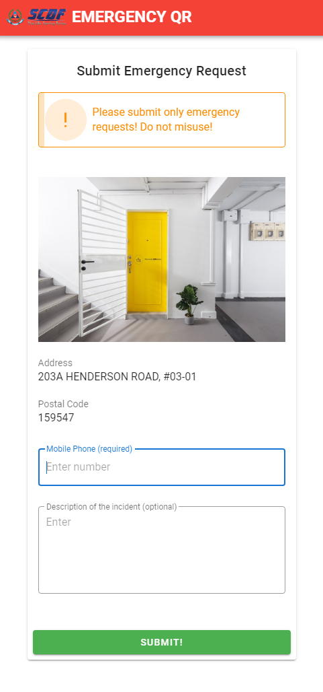
QR For Emergency is an app that helps to generate community QR codes to help SCDF quickly pinpoint the location of emergences

Slide 6


Tools used in app implementation
Database to store data used in creating the app
App Coding

Slide 7



Possible Challenges/Limitations
Small Learning Curve
Education and Adoption
QR Code limited to non-destructive emergencies

Slide 8



Possible Extensions
Prioritized
Organized
Simple

Slide 9
Future Projections?
IBM cloud technologies

Slide 10
Conclusion
Are you tired of false emergency alarms? QR For Emergency is an app that helps to generate community QR codes to help SCDF quickly pinpoint the location of emergencies so they can respond in time quickly.

